Slide 1

The Initiative -!8
#bethechange
#initiatetheideas

Slide 2

Team –diamond (INIT – 111)
AKSHAT MITTAL
(TEAM LEADER)
ADITYA GUPTA
ANKIT PRABHAKAR

Slide 3
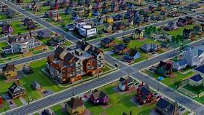
URBAN SPRAWL
Urban sprawl is another name for urbanization. It refers to the expansion of poorly planned, low density, auto-dependent development which spreads out over large amount of land, putting long distances between homes & stores which cause wildlife displacement & ecosystem disruption.

Slide 4
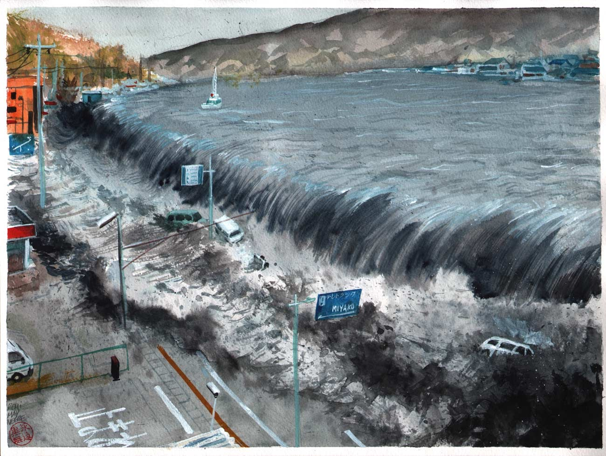
Urban sprawl- A peril
“Nearly all our cities are at risk of floods because of unchecked urbanization & depletion of water bodies”, reported by Centre for Science & Environment, a New Delhi based think tank.

Slide 5

Loss of Rural Heritage & Open space:
Rural living is a particular culture that not only provides food and corn for ethanol & soybeans but also a unique style of living. The ecological value of open space or farmland is important too. It absorbs air pollution & gives Mother Earth break from our chemical pollution.

Slide 6
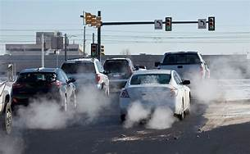
Health Hazards:
The increased level of pollution in air makes breathing a challenge causing several diseases related to lungs & bronchi. Excessive use of automobiles leads to overweight & causes ailments such as high blood pressure & heart diseases. Due to lack of fresh air people become inactive & unhealthy.

Slide 7
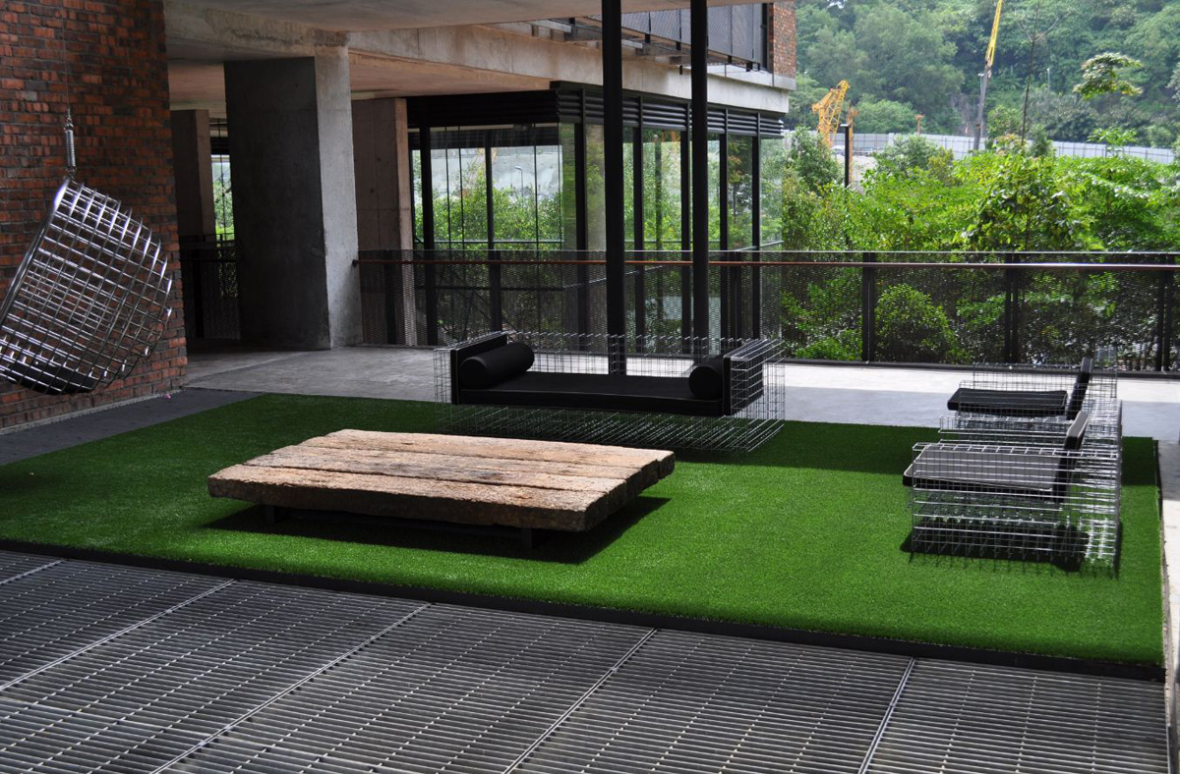
Causes of Urban Sprawl:-
Rise in standard of living: With several improvements in India, standard of living of people is enhancing day by day. This means that people have the ability to travel and commute longer distances to work & back home.

Slide 8
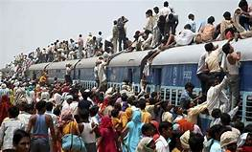
Causes of Urban Sprawl:-
Rise in population growth: As number of people in a city grows beyond capacity, the local communities continue to spread farther & farther from city centers. It leads to the creations of lightly populated suburbs.

Slide 9
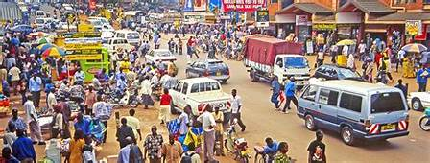
Causes of Urban Sprawl:-
Lack of urban planning: Since the settlements in suburbs have occurred naturally, it has led to cutting of trees, loss of green cover, long traffic jams, poor infrastructure & loss of wildlife. Moreover, the desire of people to live peace takes them to sprawl out to other sections of the town.

Slide 10
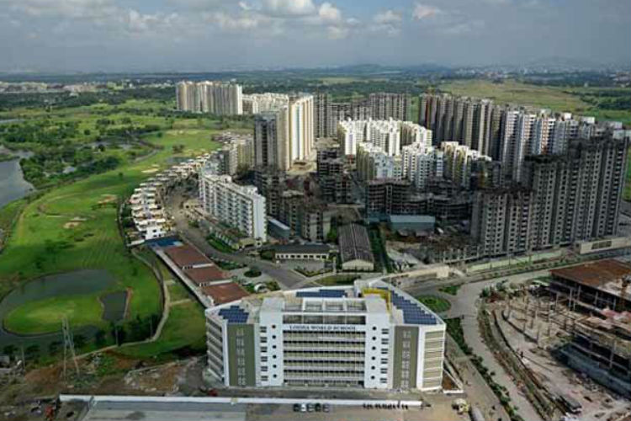
Smart Cities- A Smart Solution :
Cities accommodate nearly 31% of India’s current population & contribute 63% of GDP (Census 2011). Urban areas are expected to house 40% of India’s population & contribute 75% of India’s GDP by 2030. This requires comprehensive development of physical, institutional, social & economic infrastructure. All are important in setting in motion a virtuous cycle of growth & development.

Slide 11
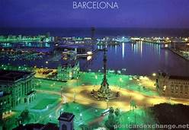
Barcelona is the first city in the Spanish State coined a “Smart City”
It is the capital and largest city of Catalonia, as well as the second most populous municipality of Spain. With a population of 1.6 million within city limits.

Slide 12
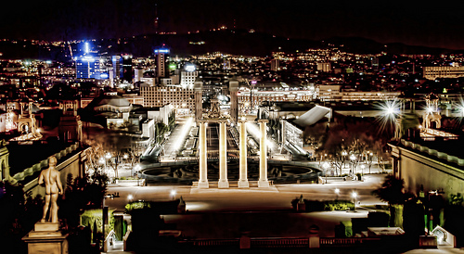
Barcelona highlights : smart lighting !
.
These lights optimize energy and use a smart function: it activates when detecting motion, but also gathers environmental information, humidity, temperature, pollution & noise.

Slide 13
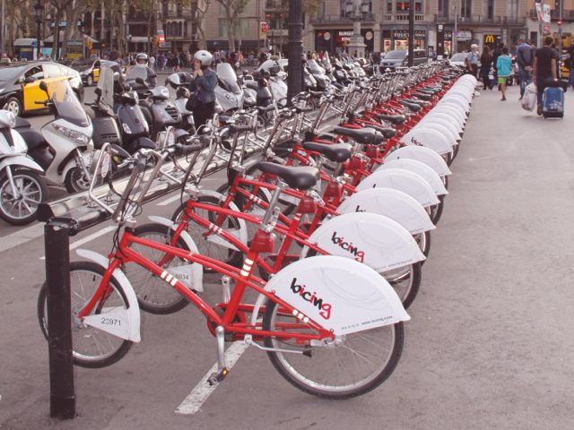
Barcelona highlights : bicycle sharing !
One pay an annual fee, get a Bicing card, scan it at any of the 400 stations, check out a bike, then check it back in at the station closest to one’s destination. Recently, the new Bicing app became available for users to check out real-time availability at stations.

Slide 14
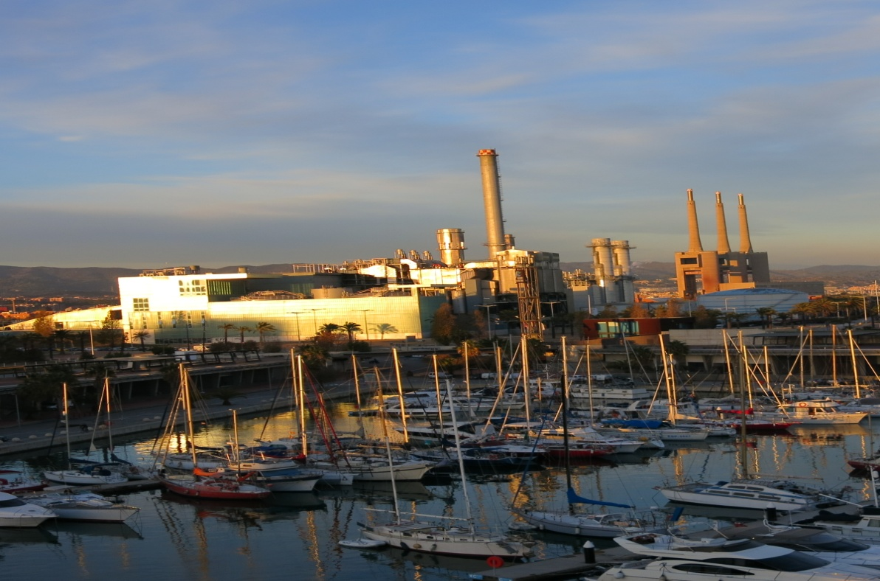
Barcelona highlights : renewable energy!
Districlima heating and cooling system “equivalent to planting 548,000 trees, or nearly 4 times the number of trees in Barcelona.” The heating uses steam from the incineration of urban waste and the cooling uses seawater for refrigerating, producing less fossil energy consumption and carbon emissions.

Slide 15
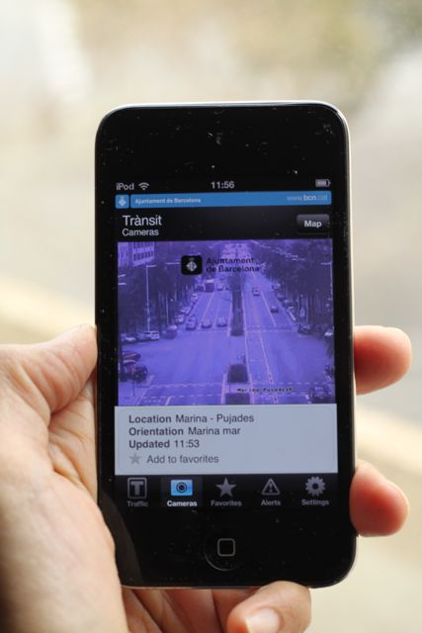
Barcelona highlights : urban mobility apps!
Point one’s Smartphone camera in any direction, and “bus stop signs, lines and the distance to them in metres will appear on the screen, superimposed on real-world images. If one turns your phone sideways, it becomes a compass and each stop is shown as an arrow pointing in the direction to take”.

Slide 16
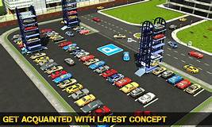
Barcelona highlights : smart parking spaces!
Drivers can get real-time information on their Smartphone to best locate a free parking space using Appark B so they don’t have to go in circles.

Slide 17
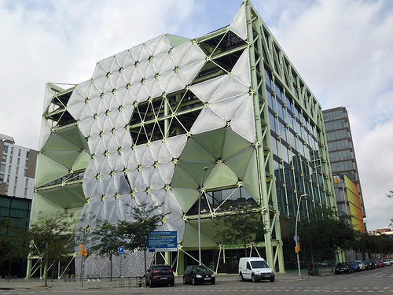
Barcelona highlights : Innovation District!
It is a regeneration project: the use of refurbished buildings in a neglected part Poblenou, a former industrial hub. Municipal leaders are engaging the private sector — companies, universities, research, and communities work in close proximity in clusters in these buildings to accelerate the pace of knowledge sharing and quickens innovation.

Slide 18
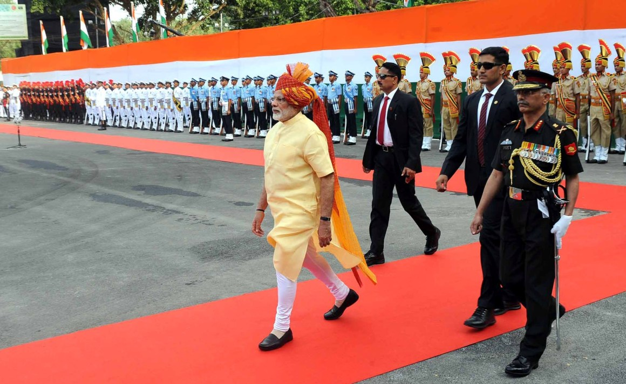
Mission smart cities: a step towards smart india!
The Smart Cities Mission is an innovative and new initiative by the Government of India to drive economic growth and improve the quality of life of people by enabling local development and harnessing technology as a means to create smart outcomes for citizens.

Slide 19
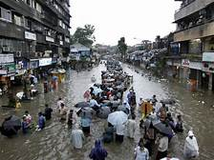
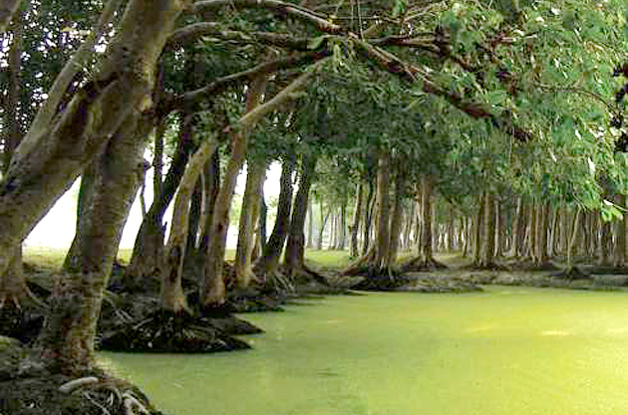
Mumbai floods: vicious urban sprawl !
In Mumbai, which has amongst the priciest real estate in the world, mangroves & wetlands have been destroyed to build office towers, which also block the mouth Mithi River. On 29 August 2017, the city received nearly a month’s worth of rainfall in a single day. Most victims lived in slums, home to more than half the city’s 20 million population.

Slide 20
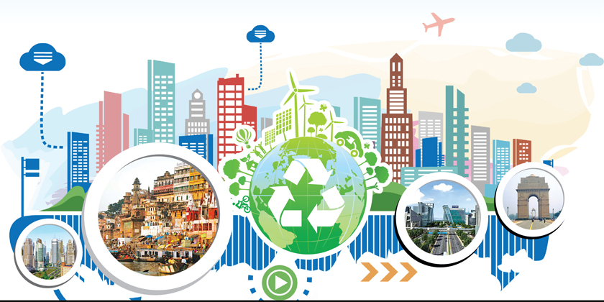
india smart city: objectives !
Assured water and electricity supply, sanitation and solid waste management, efficient urban mobility and public transport, robust IT connectivity, e-governance and citizen participation, safety and security of citizens.

Slide 21
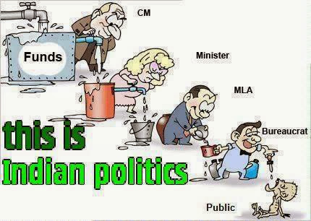

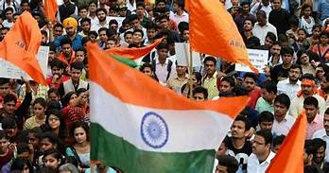

india smart city: objectives !
A Special Purpose Vehicle will be created for each city to implement Smart City action plan. The SPV will be signed with the urban local body, state government and the Centre for implement, So no way to escape by corruption.

Slide 22
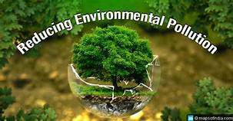
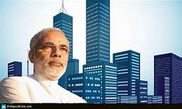
india smart city: objectives !
Public information citizens’ engagement, waste to energy & fuel, waste to, compost, 100% treatment of waste water, smart monitoring, water quality renewable source of energy, efficient energy and green building, smart parking, intelligent traffic management system. So, making cities pollution free where u can breathe. drink, feel open, peace & remain active.

Slide 23
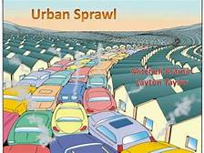
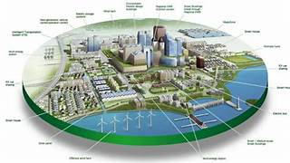
Conclusion :
Urban Sprawling is not a new thing to deal with as it has been for quite some time. However, it causes cutting down of more trees & tears up the environment.
It is inevitable but that doesn’t mean that it has to be rushed into & it should happen naturally. Smart city can be considered as an ideal solution to Urban Sprawl, as it aims to modernize Indian cities with high speed internet & efficient public transport which may evict slum dwellers leading to yet more concrete structures.

Slide 24


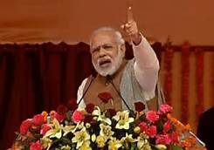
Initiatives required :
Proper education of people
social zeal
political action
To make the mission successful. Moreover, it is necessary to make it accessible to larger part of India

Slide 25

Revolution for development:
#
#bethechange
#initiatetheideas

